Slide 1


YOUR TRUSTED HIRING PARTNER
Helping Companies Find the Right Talent, Faster!

Slide 2


About Us
At Recruitrise Solutions Pvt. Ltd., we specialize in connecting companies with skilled candidates, ensuring a seamless hiring process.
We offer trained professionals, HR support, and even a dedicated space for placement drives.
🔹 Experienced & Fresher Hiring
🔹 Multi-Industry Recruitment
🔹 Complete HR & Documentation Assistance

Slide 3


Why Choose Us?
We simplify the hiring process for businesses by offering:
  Skilled & Trained Candidates – We provide freshers and experienced professionals ready to contribute from day one.
  Domain-Specific Training – Every candidate undergoes industry-relevant training before placement.
  Multi-Sector Hiring – We recruit for IT, healthcare, finance, engineering, retail, and more.
  Nearby Talent Sourcing – Get access to local candidates to reduce relocation and onboarding challenges.
  End-to-End HR Support – We assist with documentation, follow-ups, and onboarding processes.
  On-Site Placement Drive – Use our fully equipped office space for walk-ins and recruitment events.

Slide 4
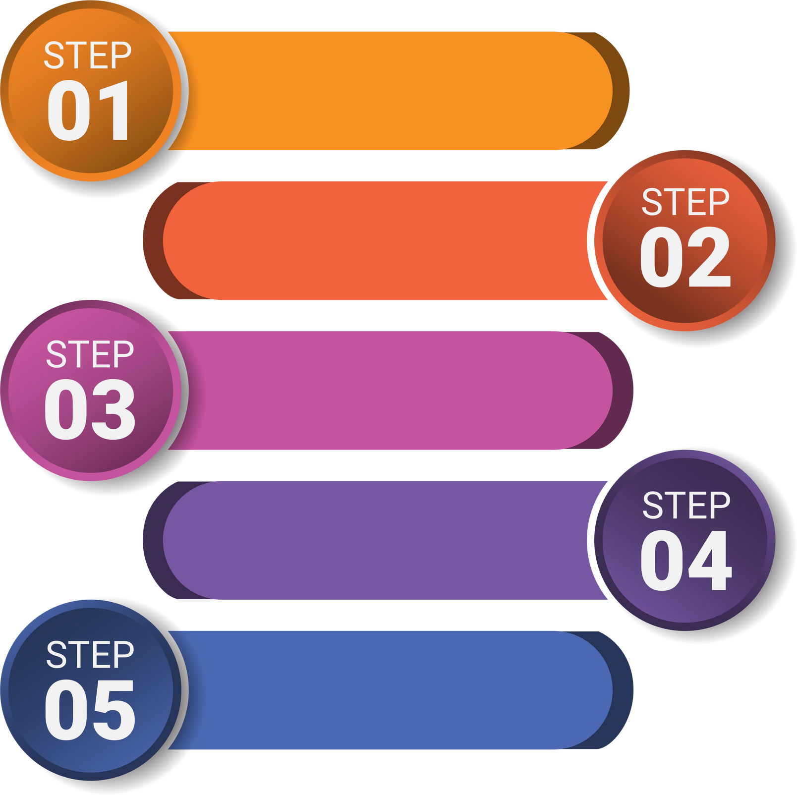
Our Hiring Process
Understanding Your Needs
We analyze your company’s requirements and job roles.
We shortlist and train candidates based on your criteria
Candidate Screening
Interview Scheduling
We coordinate interviews at your office or our premises.
We assist with offer letters, background checks, and onboarding.
Final Selection & Documentation
Smooth Joining Process
Ensuring a hassle-free candidate integration into your team.

Slide 5

Industries We Serve
We recruit professionals for multiple industries, including:
✔ Information Technology (IT)
✔ Healthcare & Pharmaceuticals
✔ Finance & Banking
✔ Engineering & Manufacturing
✔ Retail & E-commerce
✔ Telecommunications
✔ Education & Training
✔ Logistics & Supply Chain

Slide 6

Benefits for Employers
  Save Time & Resources – We handle candidate sourcing, screening, and interviews.
  Trained & Job-Ready Talent – Every candidate is pre-assessed and trained to meet industry needs.
  Reduced Hiring Costs – Our streamlined process ensures quick and cost-effective recruitment.
  Flexible Hiring Options – Permanent, contractual, or bulk hiring solutions as per your requirements.

Slide 7
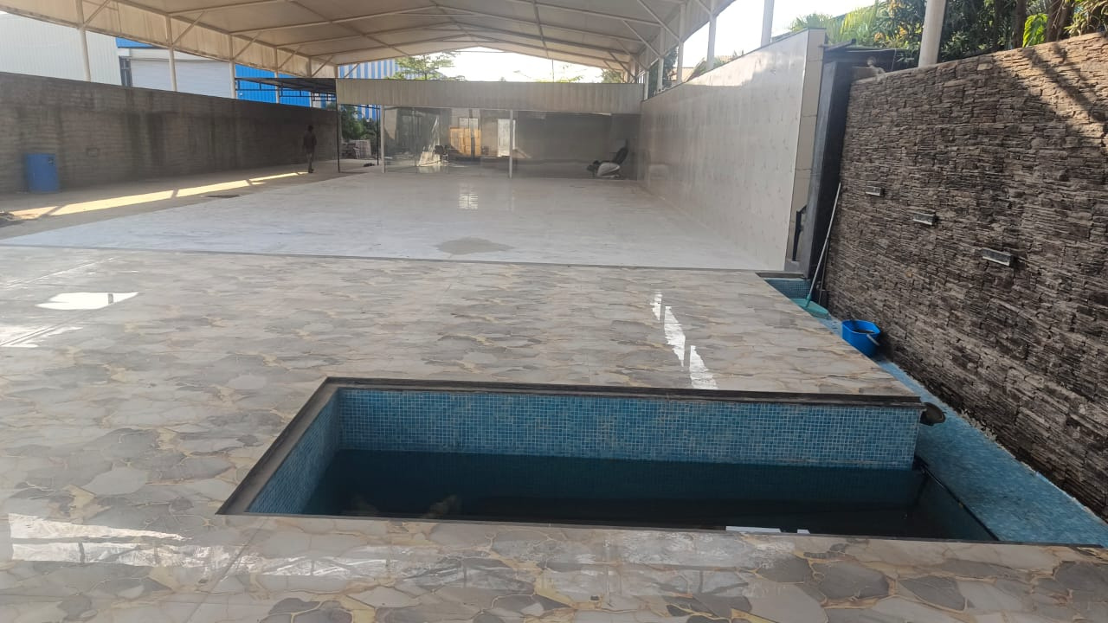


On-Site Placement Drive
Want to speed up your hiring process? 🚀
Dedicated Office Space
Conduct interviews at our premises for hassle-free recruitment.
Fully Equipped Setup
Interview rooms, Wi-Fi, and support staff available.
Bulk Hiring Support
Ideal for campus drives, walk-ins, and mass recruitment events.
A Convenient Solution for Fast & Efficient Hiring!

Slide 8

Our HR & Documentation Support
We assist companies with:
  We guide in structuring and reviewing.
  Assist in coordinating the process.
  We provide support in documentation follow-ups.
  We ensure smooth communication between employer & candidate.
Let us handle the paperwork while you focus on business growth!

Slide 9





Website
www.recruitrisesolutions.in
Get in Touch!
Address
Business park Sr no 199, behind Jotiba Mandir, Jotiba nagar, Talawade, pune 411062
Email
www.recruitrisesolutions.in
Ready to Hire the Best Talent? Let’s connect!
Phone
9923400405

Slide 10
THANK YOU
Can reach the target in a short time

